Slide 1
ACT & SAT Analysis
Providing visibility and directions if SAT & ACT test should be used as a requirement for college admission
Nelson AK

Slide 2
Agenda
Problem Statement
Data Exploration
Directions and Recommendations

Slide 3
Problem Statement
Due to COVID-19 pandemic, many colleges have introduced test-optional policy for their admission requirement.
To promote diversity and equity as well as gaining a larger pool of talents, an assessment needs to be made if standardize test such as ACT & SAT should be dropped as an admission requirement.

Slide 4
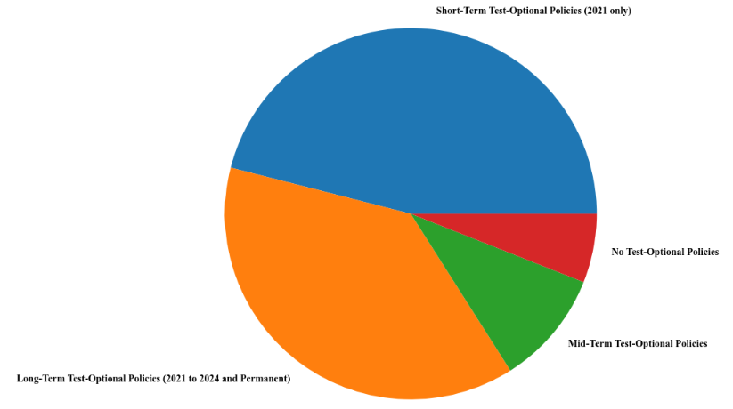
Data Exploration
Number of universities by test-optional policies
46%
Observed that only 6% of universities do not implement test-optional policy
6%
38%
10%

Slide 5
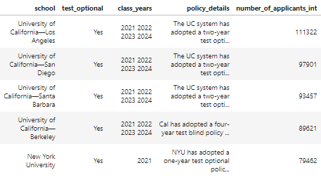
Data Exploration
Based on popularity, majority of the top schools applied are University of California campuses and all of them have implemented test-optional policy

Slide 6
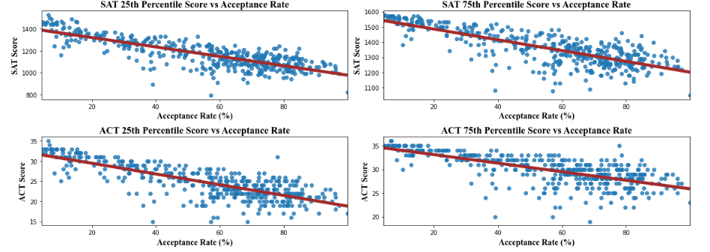
Data Exploration
There is an inverse relationship between SAT & ACT scores and college acceptance rate
This implies that universities with low acceptance rate tend to have students with high SAT or ACT scores
It reduce opportunities for students to enter their dream colleges
r = -0.8
r = -0.77
r = -0.78
r = -0.69

Slide 7
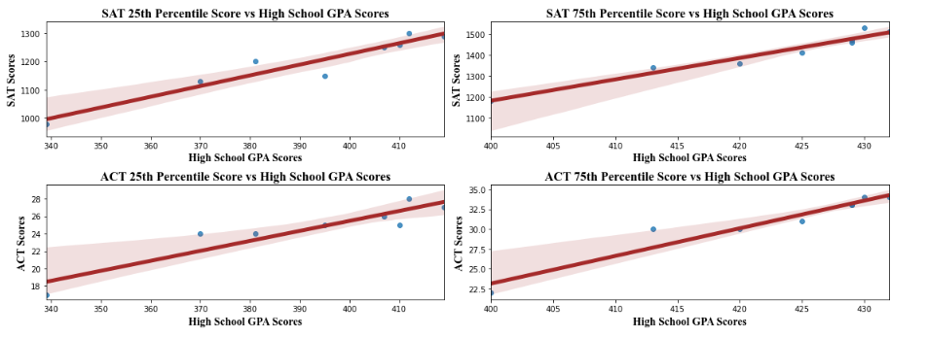
Data Exploration
However, there is a positive relationship between students’ SAT & ACT scores and high school GPA scores
This means that high school GPA scores can be used as an indicator for academic performance
r = 0.96
r = 0.98
r = 0.93
r = 0.96
Data only includes University of California campuses

Slide 8
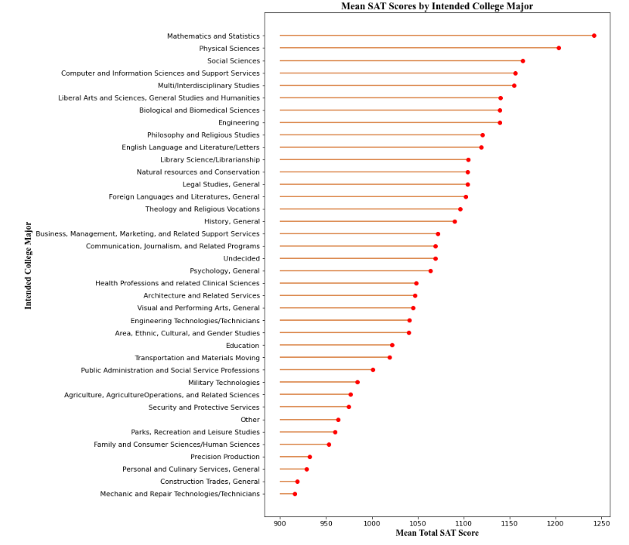
Data Exploration
With diverse backgrounds, the total scores of SAT vary by a significant amount.
If universities were to apply strict SAT & ACT tests, they will miss out a large pool of diverse talents.

Slide 9
Directions & Recommendations
As COVID-19 hits, there is a need to revise SAT & ACT tests as college admission requirement
While both SAT and ACT tests are a good measure to assess academic performance, universities should look at a bigger picture and be more flexible in applying college admission requirement to attract more diverse background
The university should move towards implementing test-optional policy as there is a key indicator that high school GPA is representative of academic performance

